Slide 1

Topic: Stem and Leaf Plots EQ: How do you compare data using back-to-back stem and leaf plots?
Year 11 Essentials

Slide 2
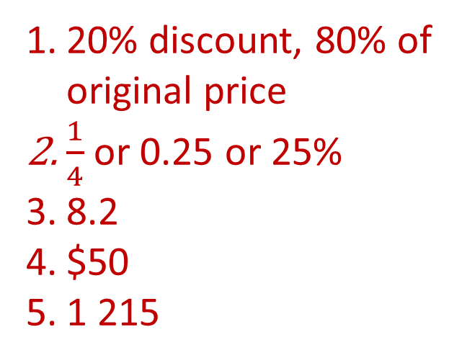
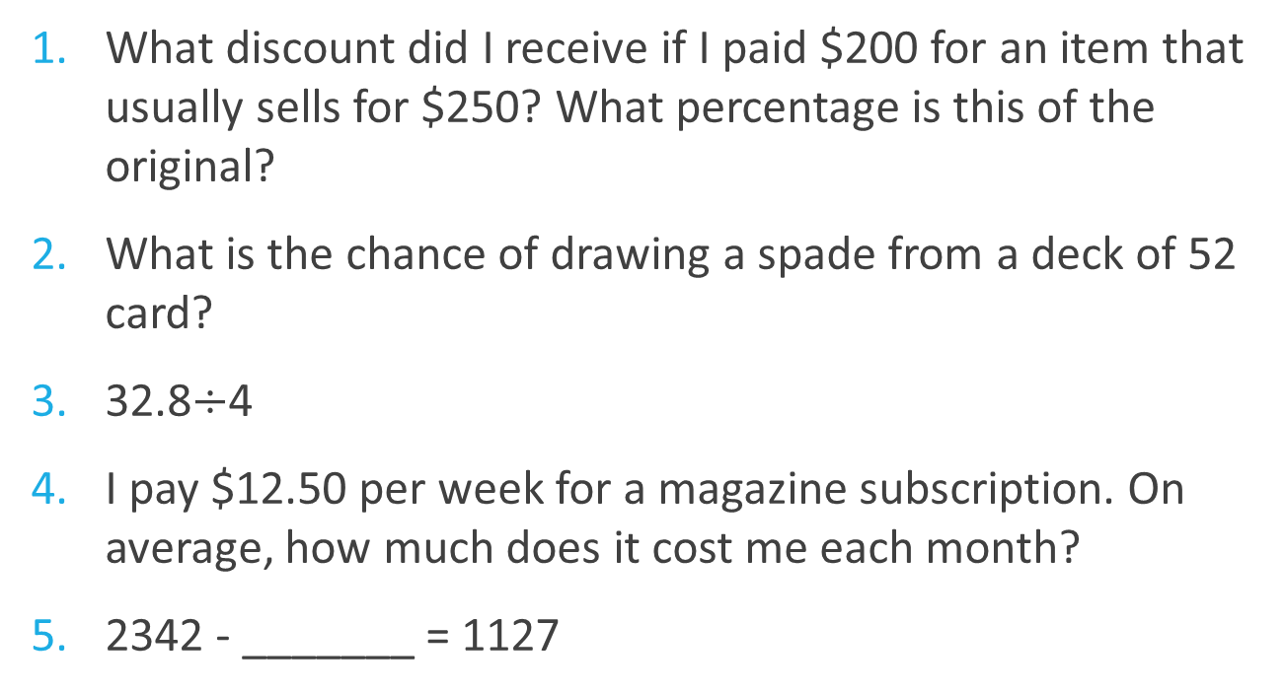
First 5
Topic: Stem and Leaf Plots EQ: How do you compare data using back-to-back stem and leaf plots?
What discount did I receive if I paid $200 for an item that usually sells for $250? What percentage is this of the original?
What is the chance of drawing a spade from a deck of 52 card?
32.8$÷$4
I pay $12.50 per week for a magazine subscription. On average, how much does it cost me each month?
2342 - _______ = 1127
20% discount, 80% of original price
$\frac{1}{4}$or 0.25 or 25%
8.2
$50
1 215

Slide 3
Topic: Stem and Leaf Plots EQ: How do you compare data using back-to-back stem and leaf plots?
What is a back-to-back stem and leaf plot?
What is an example of a stem and leaf plot?
A back-to-back stem-and-leaf plot is a method for comparing two data distributions by attaching two sets of 'leaves' to the same 'stem’.
Age of shoppers entering office supplies store
Females Stem Males
8 7 5 5 2 2 6 8
6 4 4 3 3 0 1 7 8 9
1 4 1 4 5

Slide 4
Topic: Stem and Leaf Plots EQ: How do you compare data using back-to-back stem and leaf plots?
TASK: Experiment
Page 95
Using the data you collected yesterday to create a stem and leaf plot that shows the height of students by gender or by age.
Experiment
Organise the data you collected in the previous lesson on height by age, genders or some other factors. Use this data to create back to back stem plot.
What impact does this reorganisation have on other trends that you found on your analysis yesterday?
How do you think reorganising the data in a different way would change the shape of the data?
Complete the Apply section
Complete the worksheet on back to back stem and leaf plots.

